Slide 1
JCSP Networking 2.0 (or maybe JCSP 1.1 rc4)
Kevin Chalmers
School of Computing
Napier University

Slide 2
Aims
Update to JCSP 1.1
Poisonable network channels
Remove pesky rejectable channels
Extended rendezvous
No networked AltingBarrier (yet!)
Reduce overheads
No process per channel
No LoopbackLink
LinkManager now a passive data object
Smaller message size

Slide 3
Aims
Extensibility, configurability and error handling
Layered model – easier to add extensions
NetworkBarrier!
Better NetworkConnection (soon)
All networked channels mobile (maybe)
Priority of communication layer
Buffer size
Quick creation of channels (no Channel Name Server required)
JCSPNetworkException
Interaction
Towards a universal protocol

Slide 4
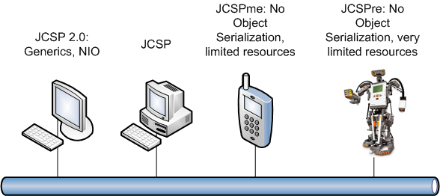

Slide 5
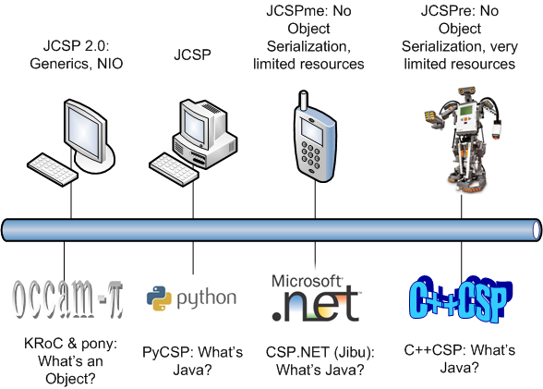

Slide 6
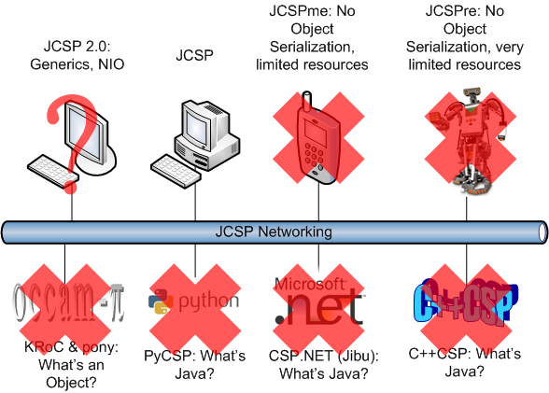

Slide 7
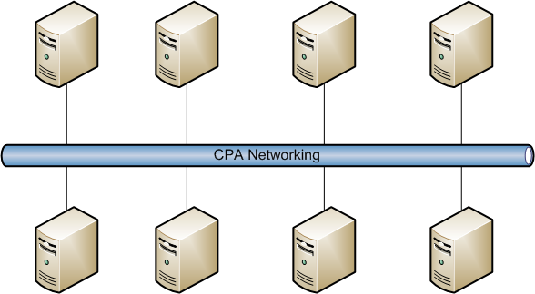

Slide 9
Towards a Universal Protocol
Messages are no longer objects
SEND | Destination | Source | <data>
<1, 0, 0, 0, 54, 0, 0, 0, 49, <data>>
Data encoding and decoding handled at channel level
User defined methods possible
Object serialization default, raw data and class loading provided

Slide 10
Layered Model

Slide 11
Layered Model

Slide 12
Creating an Application
Old way
Use Channel Name Server
Can use names – implies lookup on receiving Node
Node.getInstance().init(new TCPIPNodeFactory("CNS_IP"));
NetChannelInput in = CNS.createNet2One("channel_In");
NetChannelOutput out = CNS.createOne2Net("channel_Out");

Slide 13
Creating an Application
New way
Node.getInstance().init(new TCPIPNodeAddress(5000));
// Create Link to remote Node
TCPIPNodeAddress remoteAddr = new TCPIPNodeAddress("192.168.1.100", 4000);
// Get NodeID
NodeID remoteNode = LinkFactory.getLink(remoteAddr).getRemoteNodeID();
// Create channels
NetChannelInput in = NetChannel.numberedNet2One(55);
NetChannelOutput out = NetChannel.one2net(remoteNode, 49);
Other methods possible
Original method
From NodeAddress and VCN
From NetChannelLocation

Slide 14
Other Channel Options
Poison
NetChannelInput in = NetChannel.net2one(10);
NetChannelOutput out = NetChannel.one2net(location, 10);
Specified encoder / decoder
NetChannelInput in =
NetChannel.net2one(new RawNetworkMessageFilter.FilterRX());
NetChannelOutput out = NetChannel.one2net
(location, new RawNetworkMessageFilter.FilterTX());
NetChannelInput in =
NetChannel.net2one(new CodeLoadingChannelFilter.FilterRX());
NetChannelOutput out = NetChannel.one2net
(location, new CodeLoadingChannelFilter.FilterTX());

Slide 15
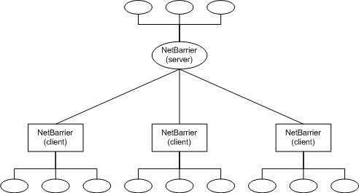
NetworkBarrier
Two tier approach
Declaring (server) end
Multiple connecting (client) ends
Each end has n enrolled processes
Server end MUST have one enrolled process

Slide 16
NetworkBarrier
Creation methods – as channels
Barrier Name Server (BNS)
NetBarrier servBar = BNS.netBarrier("barrier", 10, 10);
NetBarrier clientBar = BNS.netBarrier("barrier", 10);
Numbered barrier ends
NetBarrier servBar =
NetBarrierEnd.numberedNetBarrier(55, 10, 10);
NetBarrier clientBar =
NetBarrierEnd.netBarrier(nodeID, 55, 10);
Server end declares both locally enrolled and expected remote client ends.

Slide 17
Error Handling
Channels can throw JCSPNetworkException or NetworkPoisonException
Unchecked exceptions – no need to explicitly catch
If connection to input end fails, the output end will throw a JCSPNetworkException
If there is a problem during I/O (including encoding / decoding) a channel will throw a JCSPNetworkException
If the input end is destroyed, the output end will throw a JCSPNetworkException during next write operation
If a message is sent to an input channel that does not exist, a JCSPNetworkException will be thrown
If a channel end is poisoned with sufficient strength, every complement end will throw a NetworkPoisonException

Slide 18
Error Handling
Barriers can only throw JCSPNetworkException
If the connection to the server NetBarrier fails, a client NetBarrier will throw a JCSPNetworkException and fail.
If the connection to a client NetBarrier fails, a server end will throw a JCSPNetworkException, decrement the enrolled network process count, and allow reuse if required.
If a client end tries to enrol on a non-existent server end, a JCSPNetworkException will be thrown.
If the locally enrolled count on the server end reaches zero, a JCSPNetworkException will be thrown.

Slide 19
Mobility
Non-running process mobility via code mobility
Code loading channel filter
Reduced model from last years paper
Running processes still require termination
Poison
Migration event
Channel mobility via message boxes
Updated model soon....
Built into protocol?

Slide 20
Wrapping up
New JCSP networking available on the JCSP repository (under the Networking-2 branch)
More information and examples given in handouts
Set up
Channel creation, operations and error handling
Custom encoders and decoders
Network barriers
Mobility
Custom Link protocol creation

Slide 21
Wrapping up
Hopefully everyone’s existing programs will still work
Same interfaces
Some packages not replicated (dynamic, remote, security, settings)
More updates soon, once I’m finished writing up
NetConnections
Better channel mobility
AltingBarrier?
Any requests for functionality / information let me know, and I’ll try and help as much as I can.

Slide 22
Questions?

